Slide 1
Traditional Chinese Medicine(TCM) Prescription Modeling
Jiahui Chen, Haoyang Wang, Hanning Yu, Chao Zhang, Le Zhang

Slide 2
Table of Contents
Background and Overview
Data Processing
Modeling
Conclusion
Business Value

Slide 3

Background
Insomnia is a common sleep disorder that affects many people around the world.
Traditional Chinese Medicine (TCM) is an alternative treatment that can be used to treat insomnia.
We utilized 3 models:
1)Random Forest Model, in order to select features
2)Tree Model
3)Logistic Regression Model

Slide 4
Problem Overview
Desired Outcome:
Develop a classification model to select best prescription
Help physicians and patients to cure insomnia
Apply to real world

Slide 5
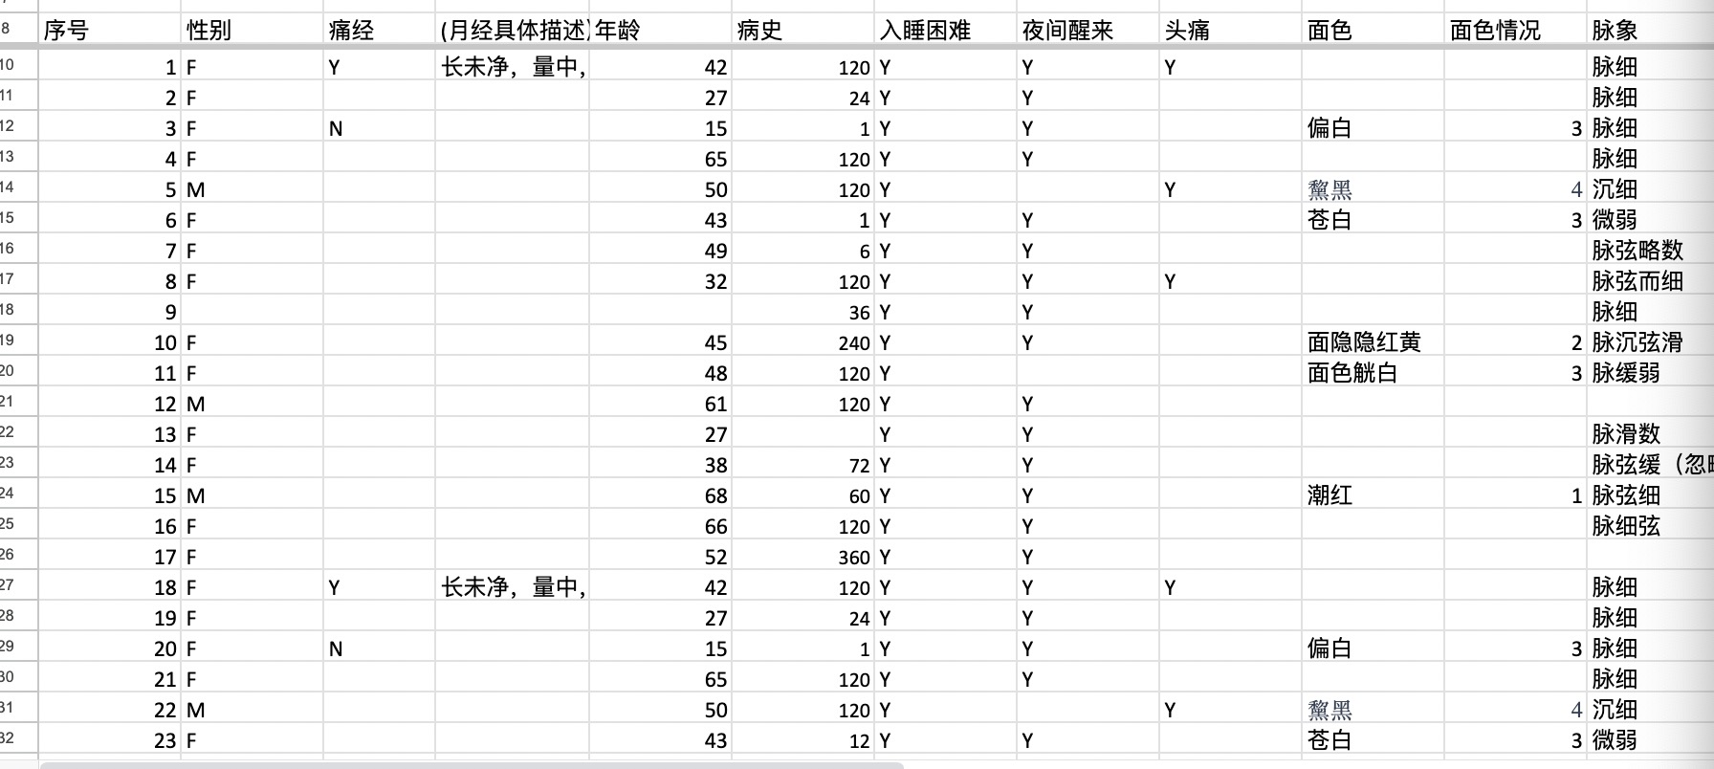
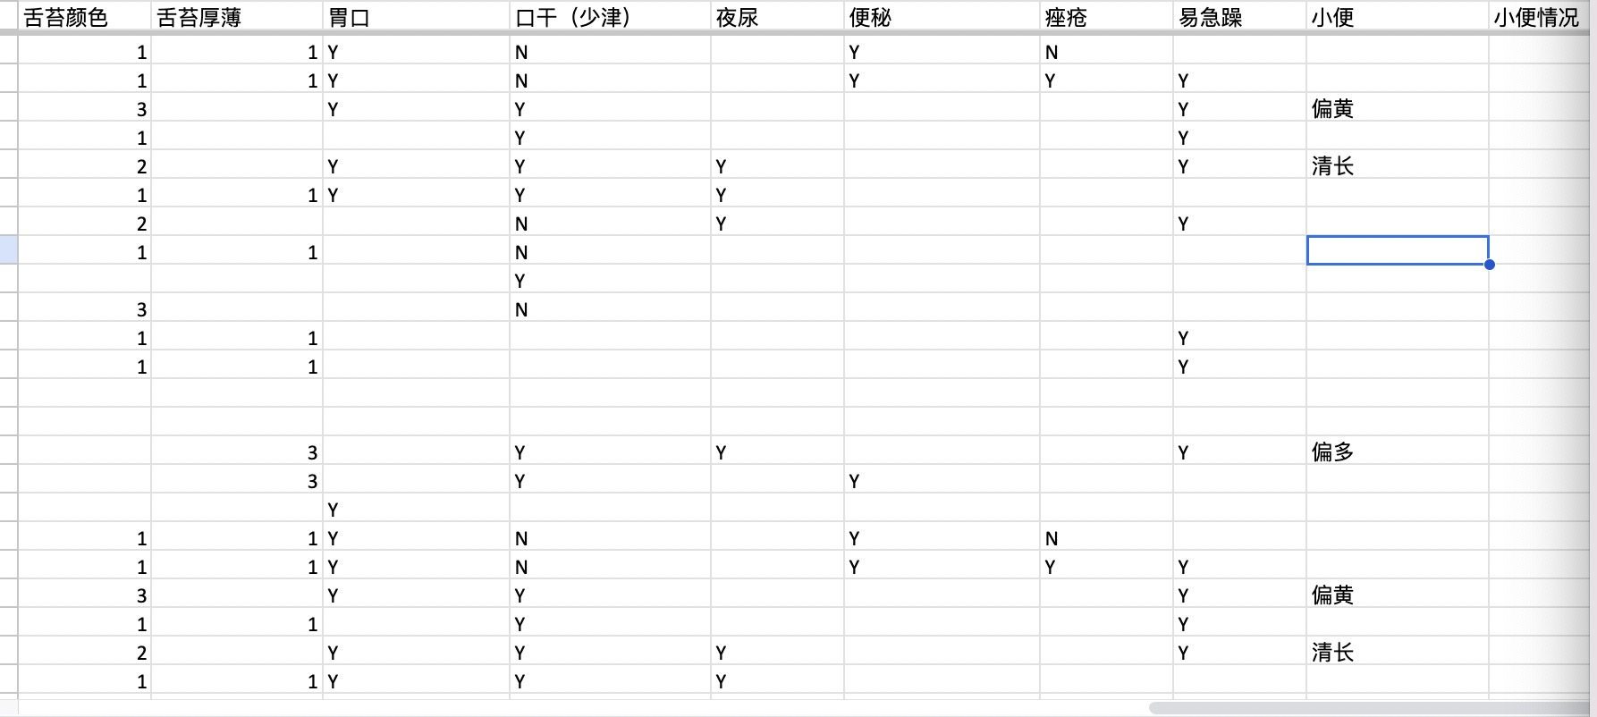
We converted text data into CSV form

Slide 6
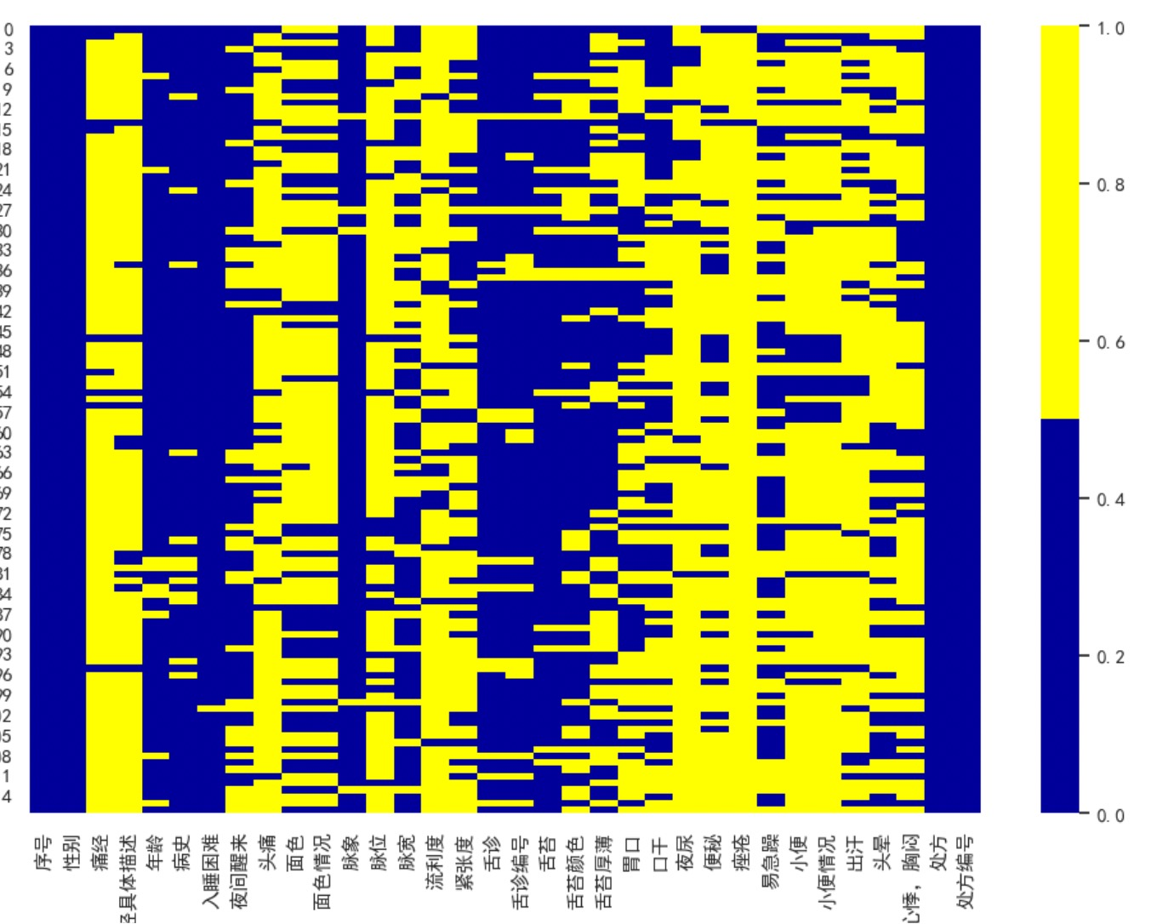
Data Collection and Processing
Data Collection
Collect data manually from Internet
Translate descriptive data into CSV file
Data Processing
Deal with Missing Data
Convert descriptive data into
categorical data
Notes:
Explain PiML tool
List the 8 Models

Slide 7
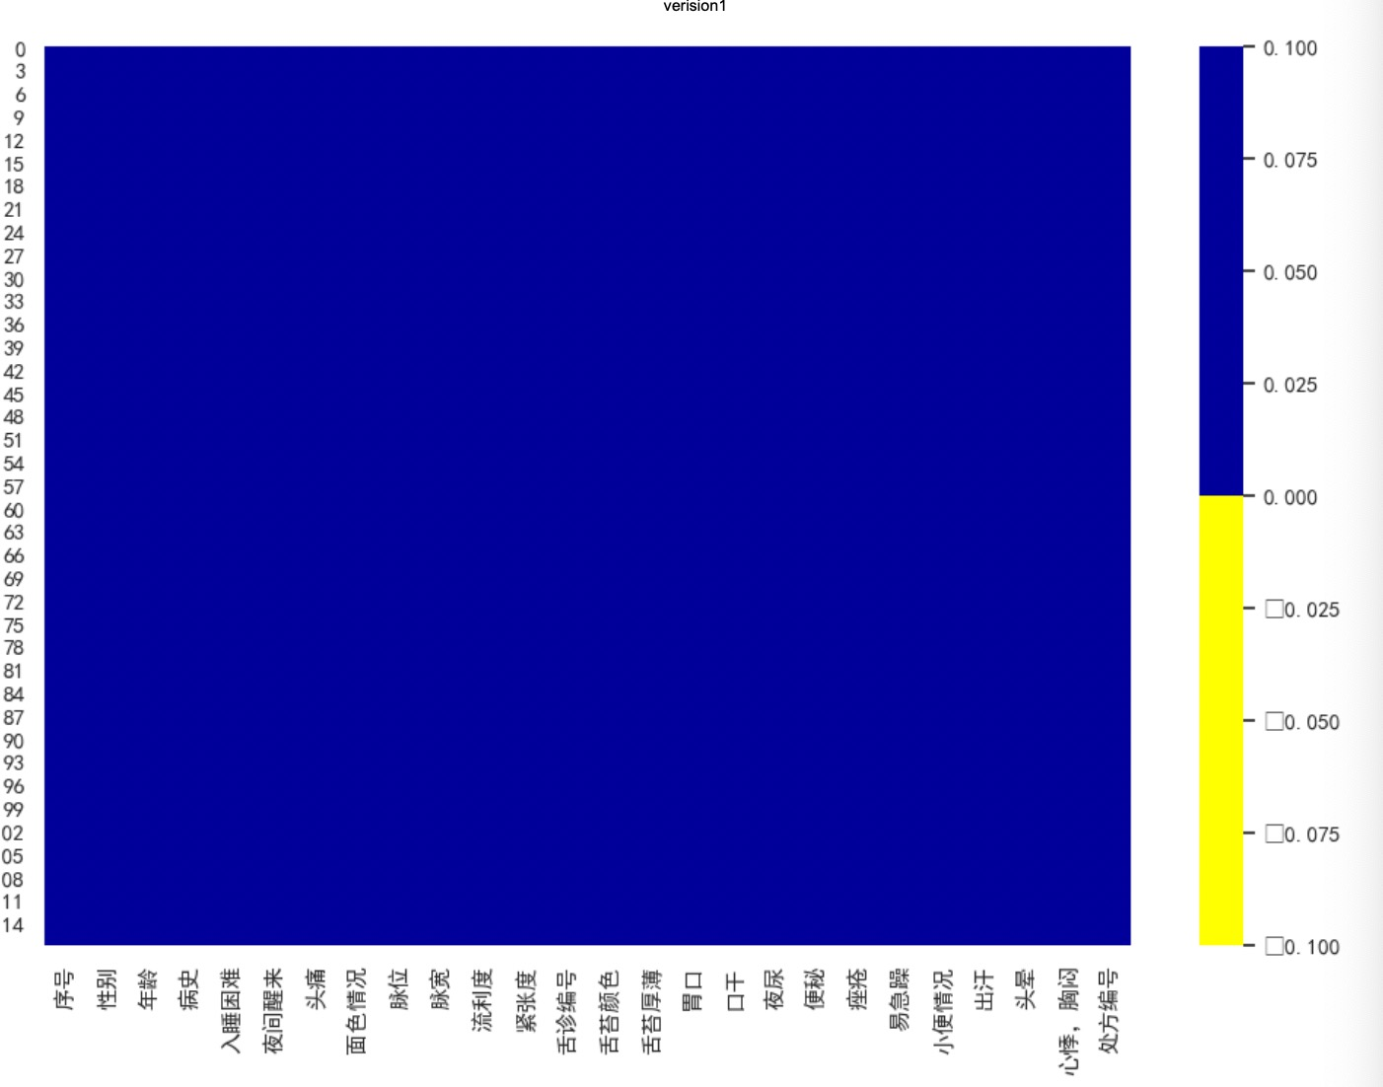
After data cleaning
No missing value

Slide 8
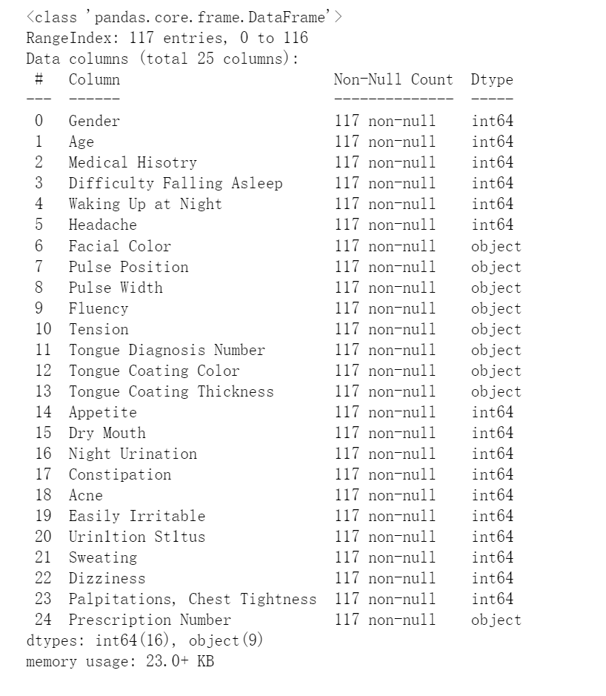
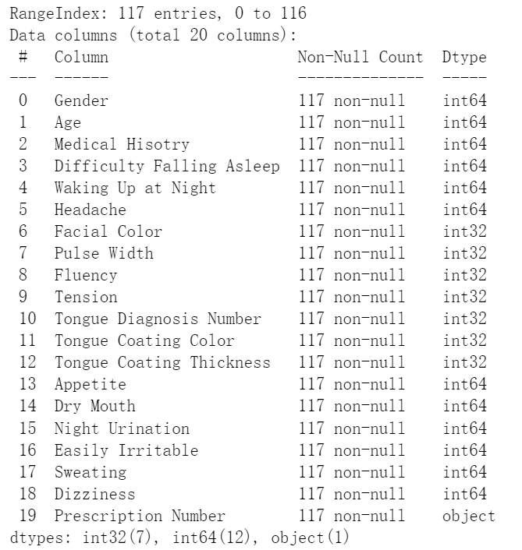
Data pre-processing
Notes:
Explain PiML tool
List the 8 Models

Slide 9
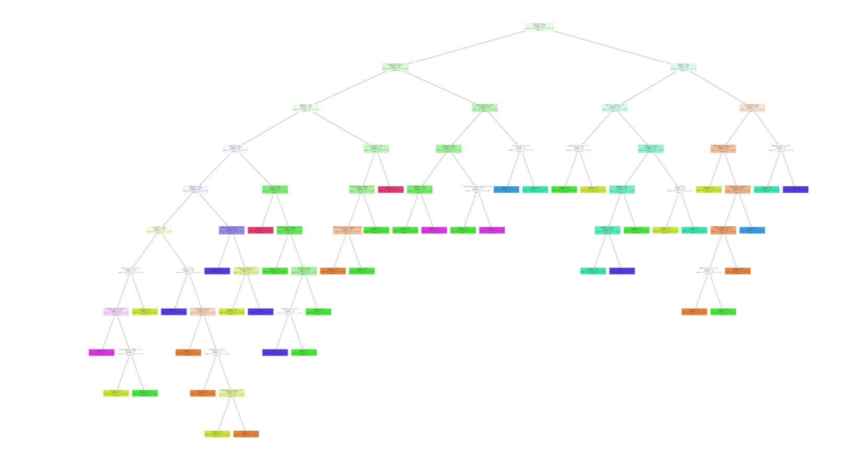
Random Forest Model
We used Random Forest Model to select features

Slide 10
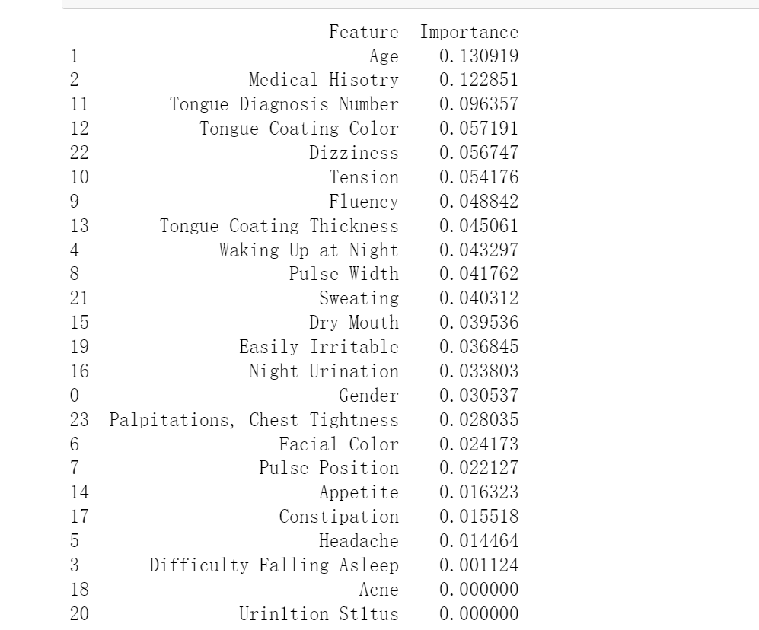
Feature selection
Drop features which has importance < 0.025

Slide 11
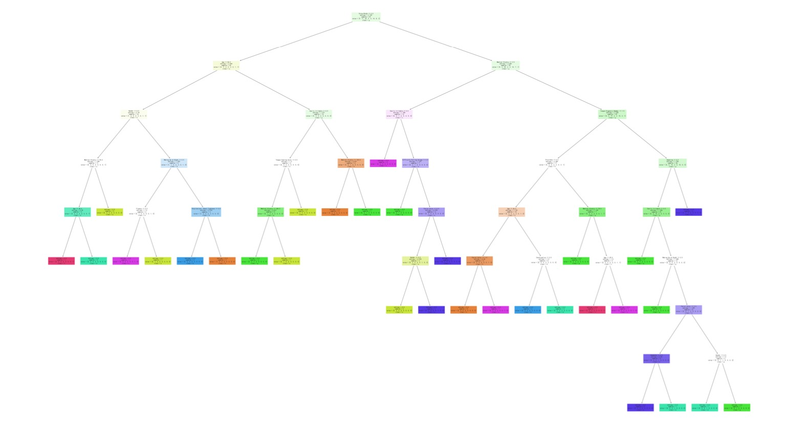
Tree Model
We used Tree Model to make predictions

Slide 12
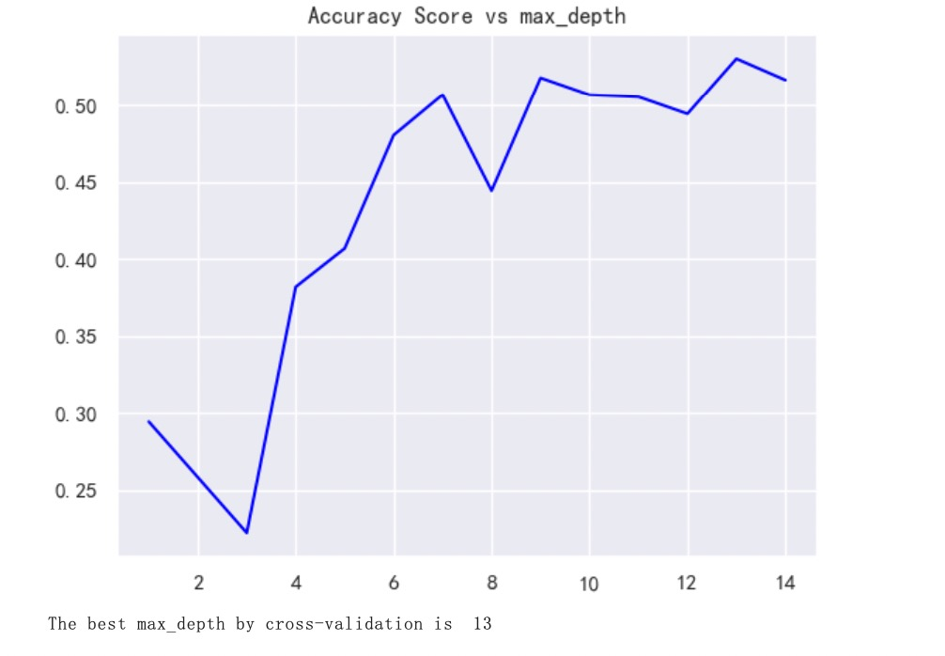
Accuracy score
data=data.drop(columns=['Acne', 'Urin1tion St1tus','Urin1tion St1tus','Constipation','Pulse Position','Palpitations, Chest Tightnes

Slide 13
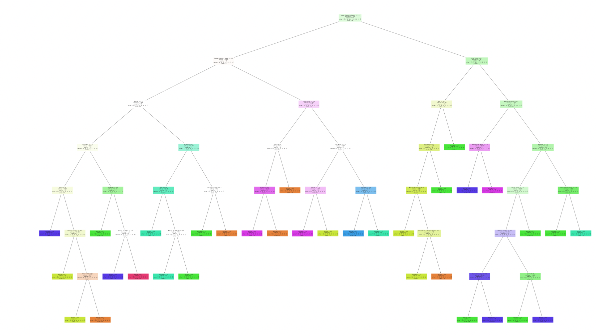
Drop column and rerun

Slide 14
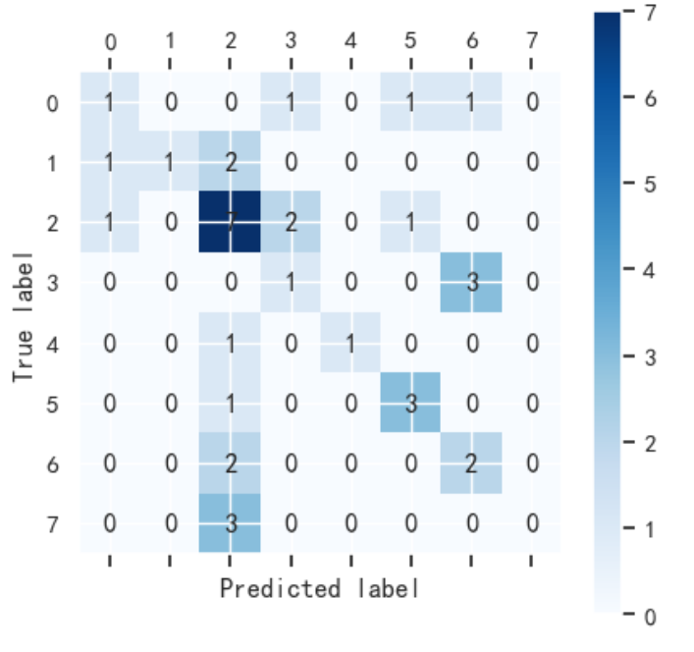
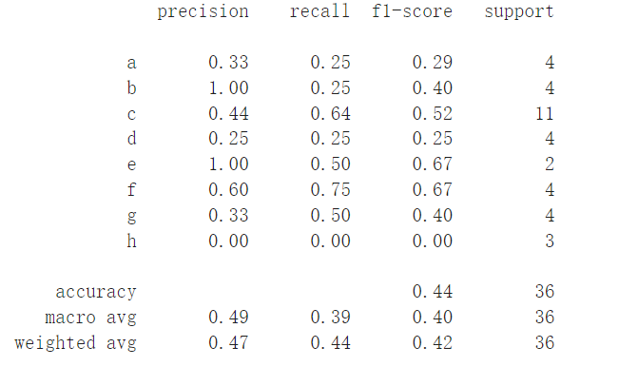
Logistic Regression Model

Slide 15
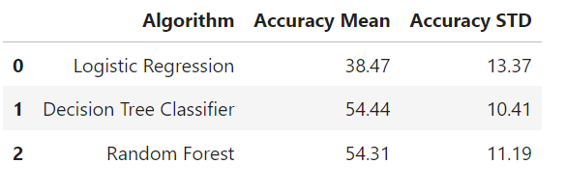
Model Performance
Models:
Random Forest
Tree
Logistic Regress
Evaluation:
STD
ACC

Slide 16
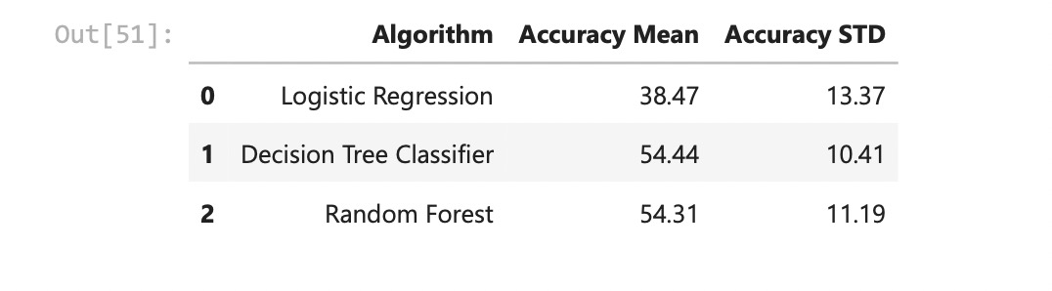
Final Model: Tree Model
We selected Tree model as our target model, as it has lowest STD and highest ACC
Model Performance: Achieve Accuracy of 54.44%

Slide 17
Considerations
Concerns:
Final model accuracy 54.44%
Personal data must be protected
Small dataset
Potential Next Steps:
Apply to real dataset
Run cost benefit analysis
Business value
Notes:
Determine final model

Slide 18
Business Value
This prescription recommendation model can assist doctors in prescribing medication and enable patients to prescribe medication for themselves.
In the future, we could apply this model in developing countries with limited medical resources.
These countries often lack doctors and hospitals, and patients cannot afford the cost of visiting a hospital. With this model, they could use it to prescribe medicine for themselves.
Notes:
Determine final model

Slide 19
Thank You!
Questions?

